Slide 1

Consultative meeting between the Staff, Union and SRC of the University of Limpopo and the Interim Council of Sefako Makgatho Health Science University
2 July 2014

Slide 2

The Name: Sefako Makgatho
Son of Chief Kgorutlhe Josiah Makgatho of the Makgatho chieftaincy at Ga-Mphahlele
He was the second President of the South African Native National Congress (SANNC) from 1917 to 1924, later named ANC
He became an intellectual a political leader, trade unionist, journalist and preacher
He lead as an educationalist and theologian. He led anti‐ pass campaigns, calling the pass ‘infernal’ and a ‘badge of slavery’. He vigorously opposed the extension of the ‘dompas’ to African women and successfully took the government to court over the Transvaal Poll Tax. He spearheaded a successful campaign in Pretoria for the right to walk on the city pavements instead of competing with vehicles and horses for space in the middle of the road.

Slide 3
How he is remembered
The writer has vivid recollections of attending a moving service at which tributes were paid to this versatile African. Enthusiastic and warm-hearted references were made to his fearlessness, his devotion to progress among his people and his willingness to spend himself in their service. All an interested observer could do was to express the wish that more would follow in his footsteps" ("Late S. M. Makgatho: . . . Great teacher-politician", Imvo Zabantsundu, October 28, 1961
President Makgatho's legacy, is the need to remain rooted in our communities and to respond to broader societal issues
Sefako Makgatho died on the 23 May 1951, in Riverside, Pretoria

Slide 4
Terms of Reference of the
Interim Council (IC)
Minister of Higher Education and Training in terms of section 20 of the Higher Education Act 1997 (Act 101 of 1997) promulgated the Sefako Makgatho Health Sciences University (SMU) in the SA Government Gazette no: 37658 of the 16 May 2014
Perform governance function
Incorporate Medunsa campus into SMU
  Establish a project steering committee
  Constitute various governance structures as contemplated by the standard institutional statute
  to establish Joint Specialised Teams

Slide 5
Terms of reference for the IC, cont
Appoint an interim executive management to manage the day to day activities
Constitute a Council
Oversee the finalization of the feasibility study relating to the establishment of the new university that includes the new university’s clinical training platform that should be synchronised, aligned and completed
To facilitate the general operations of SMU including adequate administrative, academic, staff and residential space for when the doors of the SMU open in 2015.

Slide 6
Terms of references for the IC, cont
In the Interim to share academic resources between UL and MEDUNSA campus
Develop an academic plan for a comprehensive university offering health and allied sciences programmes
Develop the academic, administrative and organisational structures for the new university
Nominate appropriate staff that will assist the DHET in the further investigation regarding the feasibility and costs of establishing and operating a veterinary faculty at SMU
Initiate the facilitation of the land transfer process to build new building

Slide 7

Academic model
Comprehensive nature of the new university
OFFERING of a PQM:
  Develop programmes from the undergraduate level through to postgraduate and postdoctoral levels;
  Supplement all programmes with a range of Higher Certificates and Advanced Certificates in corresponding fields and specialisations where applicable;
Complement all programmes with a range of Continuing Professional Development programmes and short courses.
Recommendation 6
Sefako Makgatho Health Sciences University incorporating the Medunsa campus

Slide 8

Academic model and Programme Qualification Mix [PQM]
The following programmes should continue to be offered:
Medicine
Dentistry
Nursing
Pharmacy
Occupational therapy
Physiotherapy
Radiography
Dietetics
Speech and language pathology
Audiology
Psychology
Public Health
Environmental Health
Basic sciences
Recommendation 1 – extend, expand and diversify
Sefako Makgatho Health Sciences University incorporating the Medunsa campus

Slide 9
Academic model and Programme Qualification Mix [PQM]
The following programmes are recommended as new offerings:
Biomedical Technology,
Biomedical Engineering, Clinical Technology – engineering
Health Administration and law
240 diploma in Pharmacy, Post graduate diploma in Pharmacy
Medical Informatics / information technology
Emergency Medical Care / Services
Optometry / audiology
Sports Science / Exercise science and sports medicine
Prosthetics and Orthotics
Rehabilitation
Health Promotion /primary health care / food safety / nutrition
Mental Health
Gerontology
Traditional, Complementary and Alternative Medicine (at an introductory level)
National Health Insurance and standards for health care
Veterinary Science
Recommendation 2, 3, 4 – include new types such as certificates, advance diplomas in new fields of study eg: engineering, homeopathy.
Sefako Makgatho Health Sciences University incorporating the Medunsa campus

Slide 10
Progress
Governance: The IC has started preparing Council Committees’ Policies which provides guidelines regarding the composition, mandate and functioning of the
  Charter of the Human resources of Council
  Charter of the Remuneration Committee of Council
  Charter of the Audit and Risk Management Committee of Council
  Charter of the Finance Committee of Council
  Charter of the Risk Committee
  Code of conduct

Slide 11
Progress
Administration Opening of bank account and submission to Treasury and Electronic banking applications
Submitted registrations for Income Tax, PAYE, UIF, WCC, SDL
Initial budget for Interim Council period – still to be finalised
Registration of Domain, website design and hosting, emails etc
Initiation of the database separation exercise
Started the process to set up of Facebook and Twitter accounts
Started discussions with telephony expert re best options for SMU

Slide 12
Progress
Development of terms of reference and appointment of specialist to prepare a Development Framework for SMU
RFP for External audit services
Started RFP for internal audit services
Development of a plan to establish SMU
Developed the terms of reference for the feasibility study
Establishing procurement processes

Slide 13
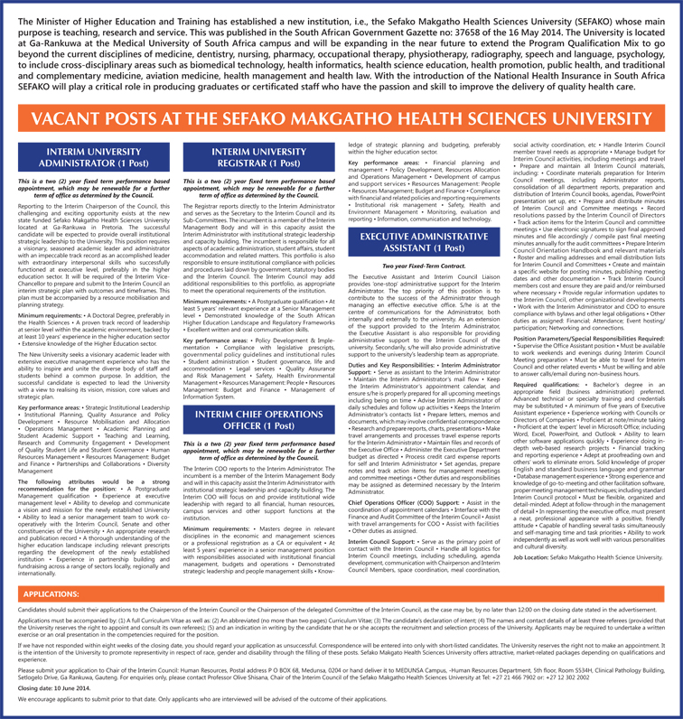

Slide 14
Sefako Makgatho Health Science University BRAND
A brand consists of five elements of brand essence, which are:
Logo & standards
Colour palette
Typefaces or typography
Imagery
Language

Slide 15
Proposed University Motto
“knowledge for quality health services”
“a pledge to the public by those within the various health disciplines that they will work toward the goal of an optimal achievable degree of excellence in the services rendered to every patient”

Slide 16

  PROPOSED LOGO
  health, science & research

Slide 17
  Proposed Colours and Palette
  Orange : prestigious institution, with wisdom, illumination and high quality
  Dark blue: Dark blue is associated with depth, expertise, and stability

Slide 18
Proposed Vision & Mission
VISION:
To be one of the top 100 universities in the world in teaching, research, knowledge transfer
MISSION:
To produce health professionals dedicated to provide a quality health service to each patient
To produce health professionals committed to learn to serve with integrity
To impart knowledge for compassionate patient centred care
To train health professionals who provide excellent and efficient services with humility
To generate research-based evidence to improve the quality of health services

Slide 19

Proposed Values
Diligence
Integrity
Commitment
Humility
Respect
Relevance

Slide 20
Type face or typography
Sefako Makgatho Health Science University (Calibri)

Slide 21
Imagery
Sefako Makgatho

Slide 22
Language
Sefako Makgatho University
SMU

Slide 23
Contact Details
Setlogelo Drive, Road, Ga-Rankuwa, Gauteng, 2000
Telephone: 012 521 4112 | Fax : 012 560 4484/0274
Temporary: Email: Beatrice.ferreira@ul.ac.za
PO BOX 114 MEDUNSA (NEW POST OFFICE BOX)
0204
Will operate from the Clinical Pathology Building, until a new building is erected

Slide 24
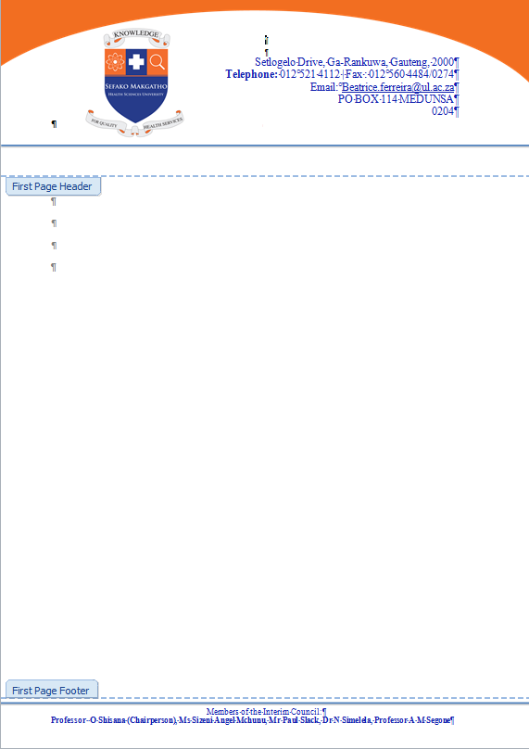

Slide 25
Looking ahead
Legislative compliance
Compliance with MOA (transitional arrangements)
Planning (agreement on strategic and operational priorities)
Appointment of an incorporation Manager to drive the process
Development of a preliminary vision, mission and common values
Projected new identity (branding)
Identification of risks and mitigation strategies
Due diligence and audits
Establishment of joint incorporation “working groups”
Implementation framework
Appointment of new management
Appointment of new Council (within 12 months from date of incorporation)
Institutional Operating Plan (within 12 months from date of
incorporation)

Slide 26
Governance and Management
Matters of URGENCY for IC:
Approving the annual budget
Determining an admissions policy
Agreeing on the fee structure and terms of payment for new and existing students
Deciding on criteria and processes for financial aid and student loans
Setting up audit; finance, HR, remuneration committees of council
Deciding on disciplinary code and rules for students and employees
Determining conditions of service
Developing an institutional operating plan
Developing a language policy

Slide 27
Academic Planning, Quality Assuarance and Research
MATTERS REQUIRING URGENT ATTENTION
Admissions policy (must be aligned without delay)
Registration – alignment; single database
Academic Calendar
Fee structure
Student financial aid/ bursaries
Disciplinary code and rules
Centralisation or decentralisation of student admin processes

Slide 28
Human Resources
Change management
Harmonisation of HR policies and procedures (not limited to…)
The appointment and promotion of academic and support staff
Working hours
Retirement policy
Advertisement of posts
Appointment of Deans
Probation
Private work and consulting
Selection and search committees
Study and sabbatical leave
Workload models
Research ethics and code of conduct
Intellectual capital/ property
HIV/AIDS
Holding of public office
Relationships btw staff and students
Relocation allowances
Absenteeism and desertion
Sexual harassment
Staff development and training
Salary supplementation
Travel and disbursements
Discipline and grievance policy and procedures
Employment equity
Occupational Health and Safety
4.5 Relations with Trade Unions and other staff associations are essential and must begin immediately
(Labour Relations Officer)

Slide 29
Financial Management
KEY ISSUES REQUIRING ATTENTION
Financial governance and management
Policies and procedures
Financial systems
General accounting processes
Budget and budgetary control processes
Salary admin
Student fees and related charges
HR
Financial reporting and financial statements

Slide 30
ICT
AUDIT:
IT software licenses
Teaching support systems
Major admin systems eg timetabling
Desktop and laptop systems
Procurement and Support contracts
Internal service provision
People eg skills of individual staff
Operational costs

Slide 31
Properties, Buildings and Services
Land; state of buildings, residential space; rentals
Fast track the building of facilities for student accommodation, learning rooms, administrative offices and other buildings
Plan for improvement of physical infrastructure, including refurbishment of current infrastructure
Maintenance of buildings and equipment
Alterations: property and equipment
Provision of municipal services
Plan for improvement of road infrastructure and transport

Slide 32
Application and Registration of students
Timing of transferring existing students to SMU –January 2015
Marketing the new SMU to students
Applications for new students into SMU
Application forms
Fees
Degree courses
Short courses
Mode of teaching: at university and distance learning
Teaching staff
Office to manage this function

Slide 33
Comments, Q&A

